Slide 1
Introduction to TensorFlow
ACM ML 3/4/2019

Slide 2
What is TensorFlow?
https://www.tensorflow.org/
Open-source library for high-performance numerical computation.
Specifically designed with Deep Learning in mind, provides many high-level features to ease the development of deep learning models.
Multi-platform, runs on all major OS’s.
Can be easily distributed across multiple CPUs and GPUs, or across multiple servers.
Basic Principle: Use the Python API to define a data-flow graph to represent our complex numerical computation (e.g. training a neural network). TensorFlow then runs this graph using optimized C++ code.

Slide 3
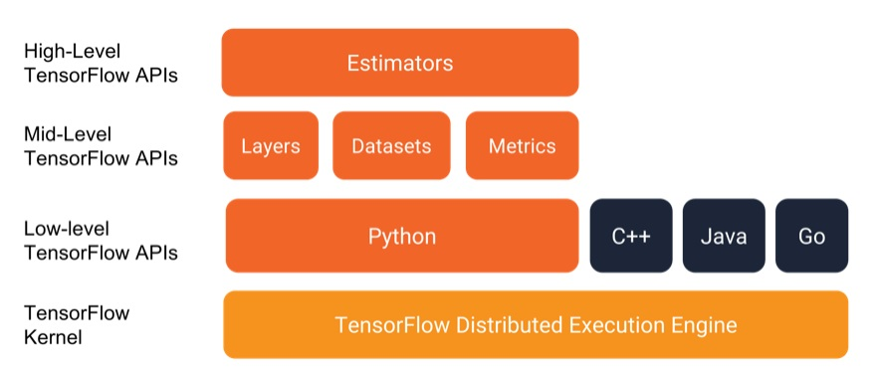
Overview of TensorFlow software library

Slide 4
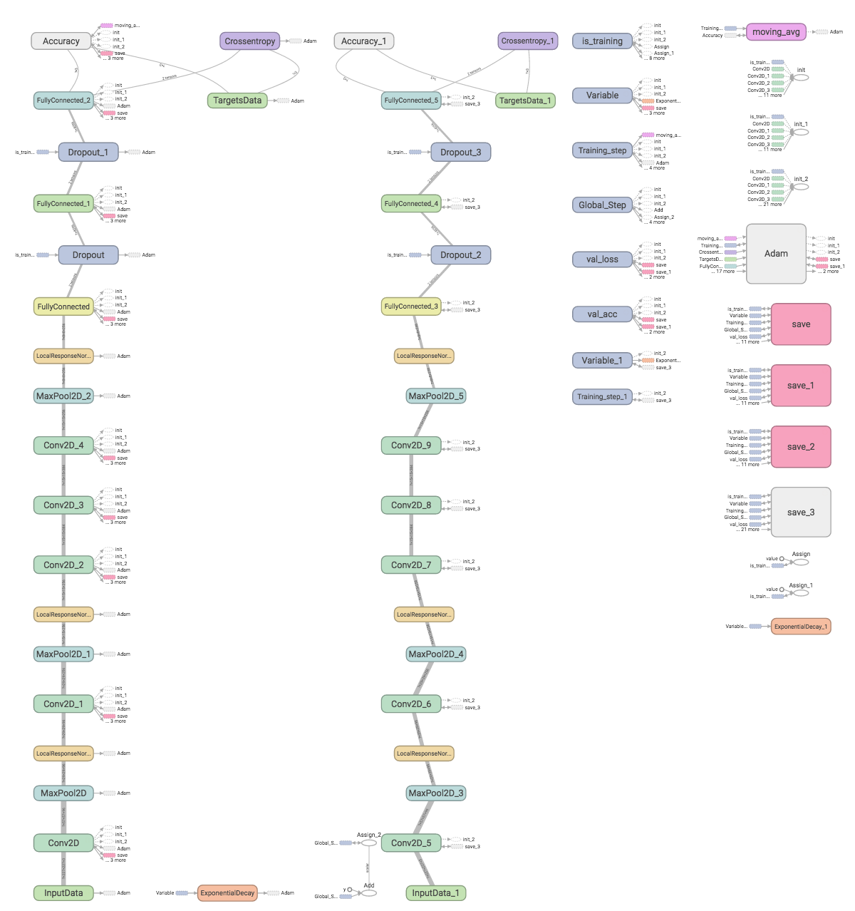
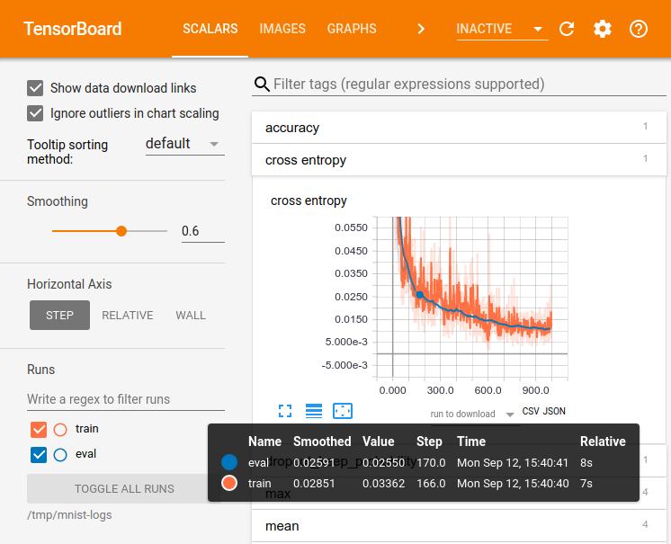
TensorBoard: “Watch your tensors flow”
Tool for creating visualizations of our data-flow graphs, as well as tracking important metrics, such as training loss and accuracy

Slide 5
Let’s Get Started!
Additional Resources:
TensorFlow guide https://www.tensorflow.org/guide
TensorFlow in 5 minutes https://www.youtube.com/watch?v=2FmcHiLCwTU
Hvass-Labs TensorFlow tutorials https://github.com/Hvass-Labs/TensorFlow-Tutorials
Hands-on TensorBoard https://www.youtube.com/watch?v=eBbEDRsCmv4

